Slide 1
Top 200 Spotify Chart Analysis using Spark and SQL
ALY6110 (80443) —— Data Management and Big Data
Group Beta
Trieu Vo vo.trieu@northeastern.edu
Jack Brown brown.jac@northeastern.edu
Chuanzhang Tian tian.chu@northeastern.edu
Lei Fang fang.lei1@northeastern.edu
Dongkai Yu yu.do@northeastern.edu

Slide 2
Summary
We looked at the dataset 'Spotify Charts' from Kaggle
26,173,514 observations
9 columns
including title, rank, date, artist, url, region, chart, trend, and stream.
This dataset contains all the "Top 200" and "Viral 50" charts published globally by Spotify from 2017 to 2021. We focused on the Top 200.
Our analysis contrasts the streams of the most and least popular artists in the Top 200.
Most popular - Ed Sheeran
Least popular - Aspova
Python, Pandas, Matplotlib, Spark and SQL were used for analysis.

Slide 3
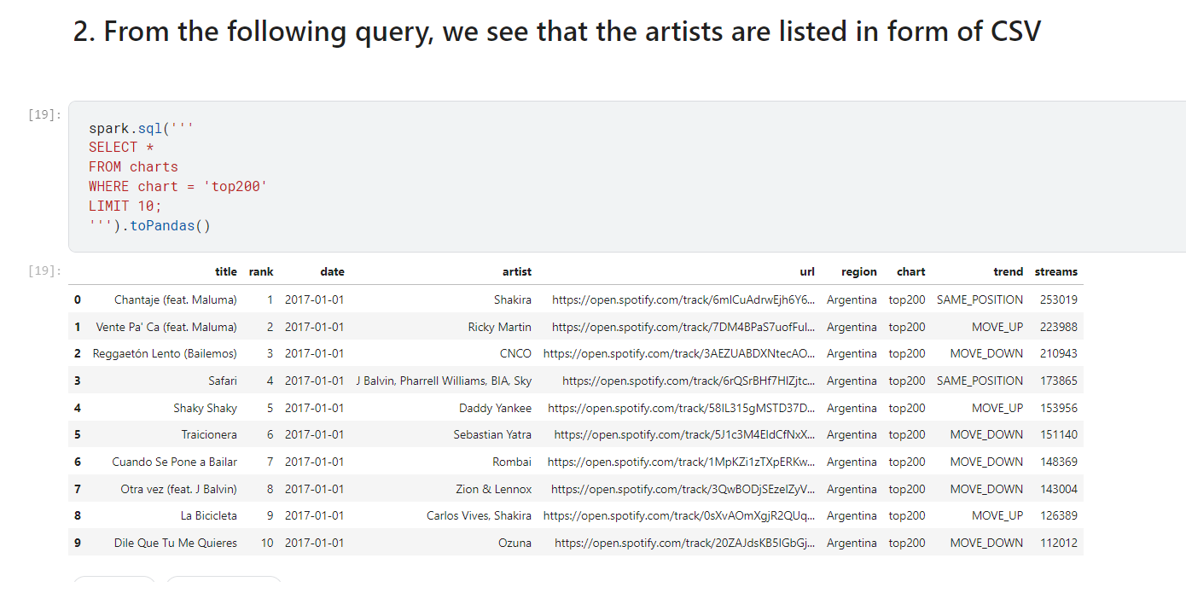
Content
We began with an overview of the data

Slide 4
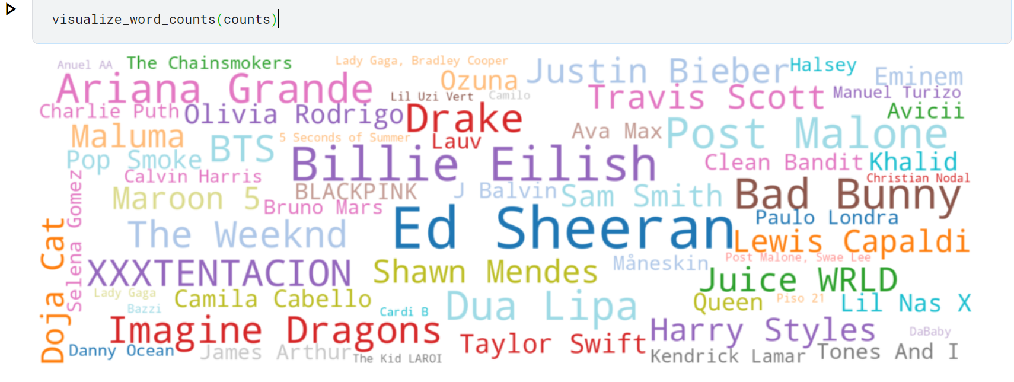

Slide 5
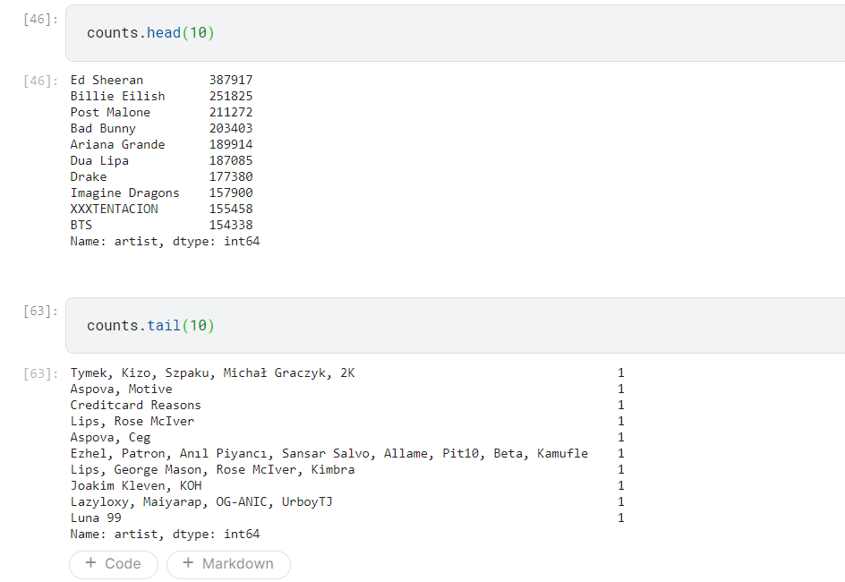
This counts and sorts all observations of songs by artists in 70 countries in Spotify's Top200

Slide 6
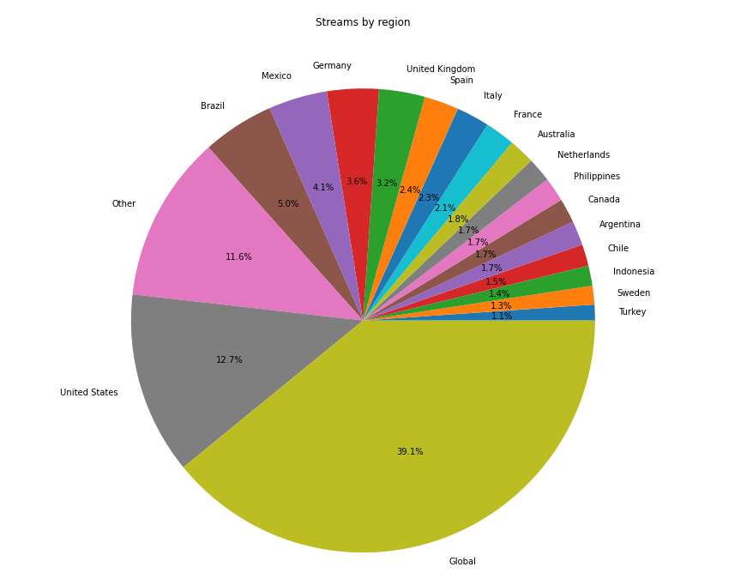
Aspova
Ed Sheeran

Slide 7
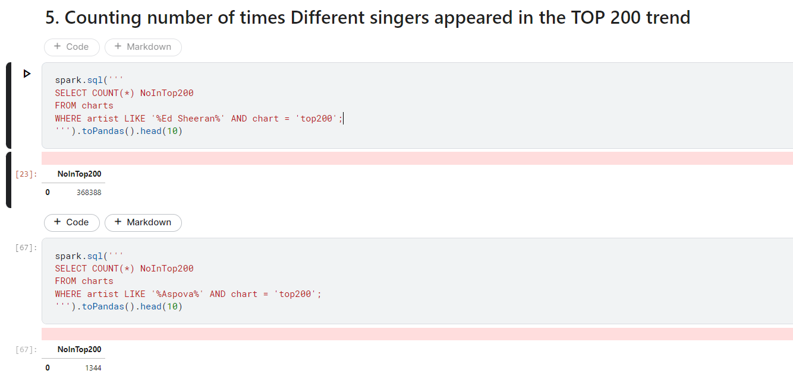
Ed Sheeran appeared in the Top 200 300 times more than Aspova

Slide 8
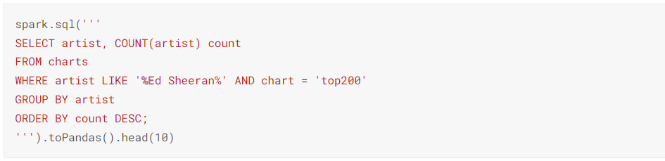
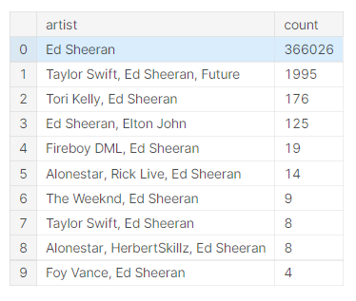

Slide 9
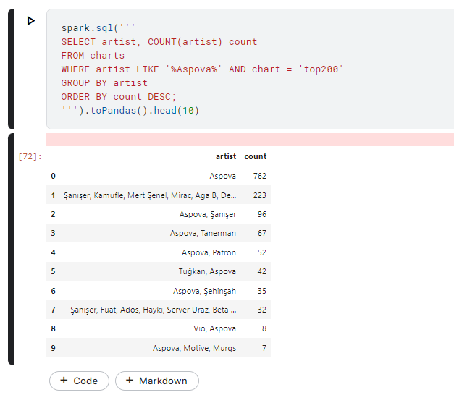
Ed Sheeran and Aspova are both more successful solo
Ed Sheeran's songs are 500 times more popular than Aspova's songs

Slide 10
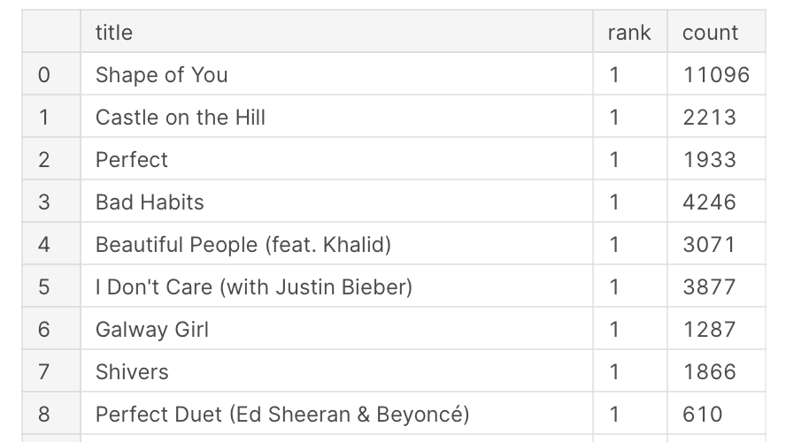
The highest ranks the songs of Ed Sheeran and Aspova have attained

Slide 11
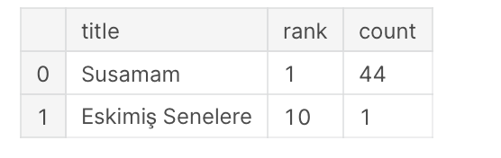
The highest ranks the songs of Ed Sheeran and Aspova have attained
Collaboration
Solo
Aspova only has 1 song in rank 1
Susamam is a collaboration song of Aspova and it ranks 1
Collaboration is better for Aspova to be more popular than solo
And for Ed sheeran, solo will be better

Slide 12
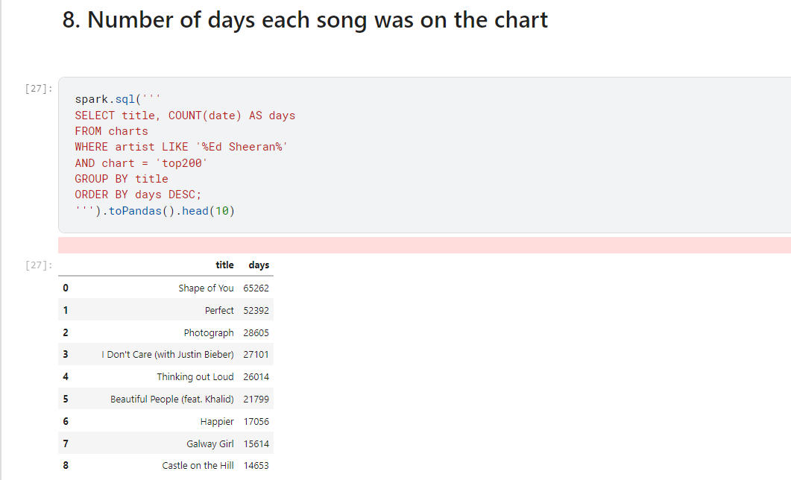

Slide 13
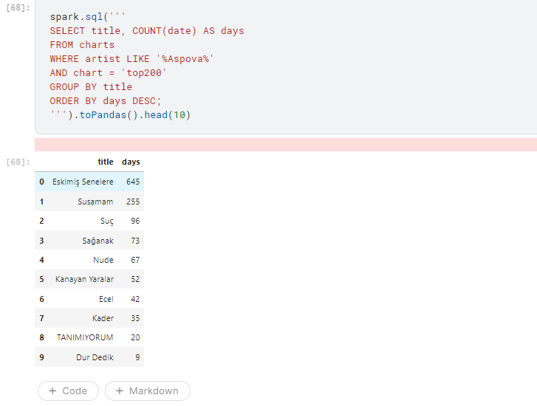
Shape of You of Ed has appeared in the Top 200 100 times more than Aspova's Eskimiş Senelere
The top songs of Ed Sheeran meet the demands of audience better than that of Aspova => They last longer on the Spotify Top 200

Slide 14
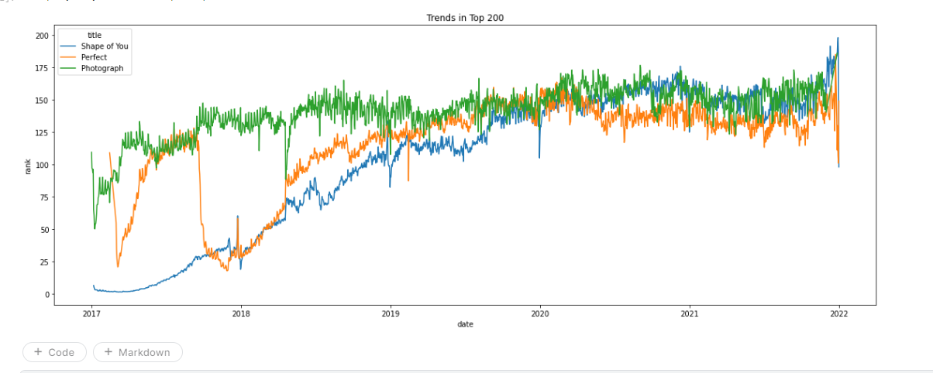
Rank trends for Ed Sheeran’s songs
Songs of Ed Sheeran began in rank 1
Slowly decreased to rank 200, but still in the Top 200 chart

Slide 15
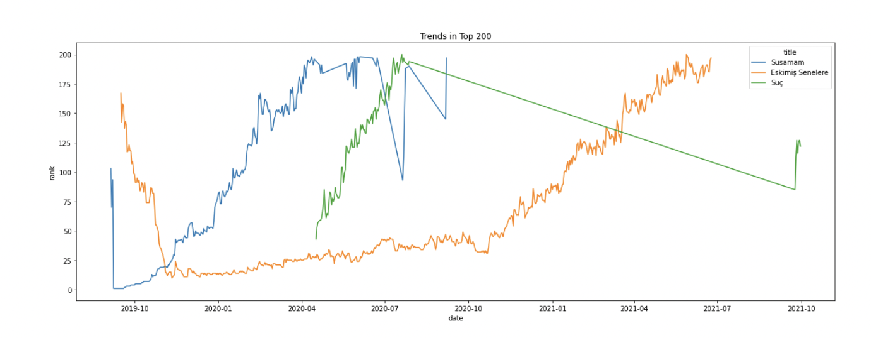
Rank trends for Aspova’s songs
Three different trends
Wild fluctuations
Songs of Aspova began in rank below 100, then quickly increased to rank 1, then slowly decreased to rank 200 and then were out of Top 200 chart

Slide 16
Comments
Pros: Real-time dataset with ample size; Accessibility
Cons: Area, time
Challenges:limited number of fields

Slide 17
Conclusions
Findings:
Ed Sheeran appeared in the Top 200 300 times more than Aspova and Ed’s songs appeared 6 times more than Aspova’s songs
Songs by Ed Sheeran are in English and have been popular all over the world, but Aspova's songs are in Turkish, so they were only popular for a short period of time
Ed Sheeran performs better in solo songs, while Aspova's most popular song Susamam is a collaborated song
Recommendations:
Aspova should focus more on the quality of his songs and marketing than the number of songs.
Aspova should collaborate with famous artists to make his music product much more popular.
Aspova should publish more songs in English to join the global music market and focus on the long-run marketing to keep his songs on top

Slide 18
References
Dave, D. (2022). Spotify Charts. Kaggle. https://www.kaggle.com/datasets/dhruvildave/spotify-charts

Slide 19
Appendix (code)
We publish our code at this link on Kaggle: https://www.kaggle.com/code/vhtrieu/aly-6110-spotify-charts-analysis/notebook

Slide 20
Q&A

